Slide 1


Title: ROLE OF MULTIPARAMETRIC MRI IN STAGING OF CARCINOMA BLADDER
ABSTRACT ID:
CATEGORY: GUT -----
PRESENTING AUTHOR: DR.SREE VANDANA.G
COAUTHORS : Dr. BABU PETER.S
INSTITUTE: Barnard Institute of Radiology, Madras Medical College.
FOR PRIZE PAPERS ID , CATEGORY
AND PRESENTOR NAME ONLY

Slide 2

AIMS AND Background
To determine the accuracy of MRI in detecting Detrusor muscle invasion and staging of bladder cancer.
Bladder cancers are categorized according to the TNM system, in which T category represents the degree of Detrusor invasion.
Determining the correct T category is important because it directs treatment decisions.

Slide 3
MATERIALS & METHODS
STUDY CENTRE | Barnard Institute of Radiology,Madras Medical College, Rajiv Gandhi Government General Hospital,Chennai.
STUDY DESIGN | Prospective Study
METHODOLOGY (MATERIALS AND METHODS) | Patients with suspicion of Bladder growth on USG or CT were subjected to Multiparametric MRI which included a combination of anatomic (T1W & T2W) and functional imaging sequences (DWI and Dynamic contrast enhanced imaging) for adequate staging & the results were correlated with HPE.
INCLUSION CRITERIA | Patients with clinical suspicion of Bladder carcinoma or USG findings of neoplastic bladder growth
EXCLUSION CRITERIA | Patients with presence of MRI incompatible cochlear implants or pacemakers. Patients with orthopnea or claustrophobia.
SAMPLE SIZE | 25 cases

Slide 4
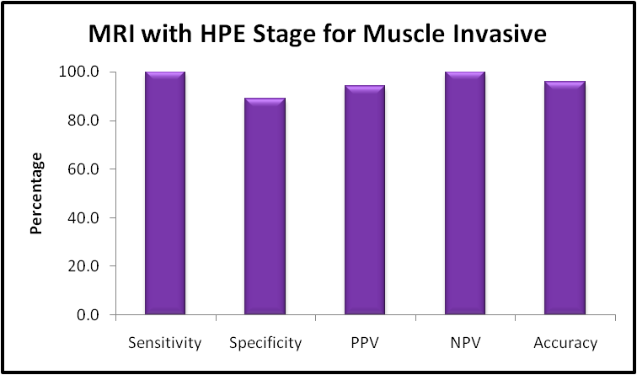
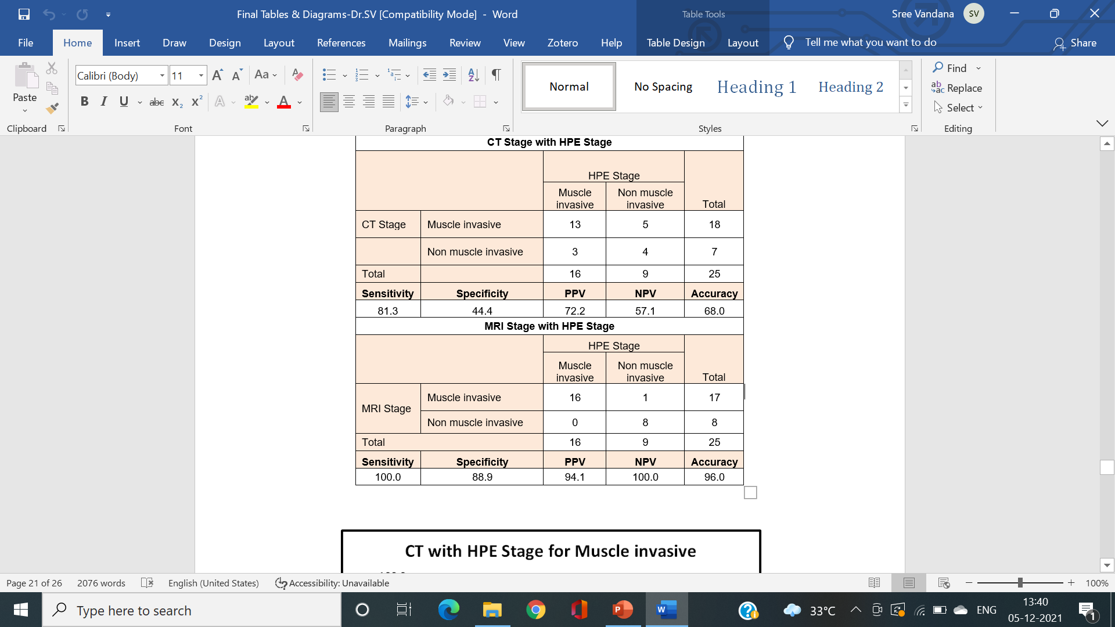
Observation, Analysis & Results
The Presence of Detrusor muscle invasion detected by Multiparametric MRI were correlated with histopathological findings.
The collected data were analysed with IBM SPSS Statistics for Windows, Version 23.0.(Armonk, NY: IBM Corp)
Statistically significant correlation was found between MRI findings & HPE with p-value < 0.05.

Slide 5
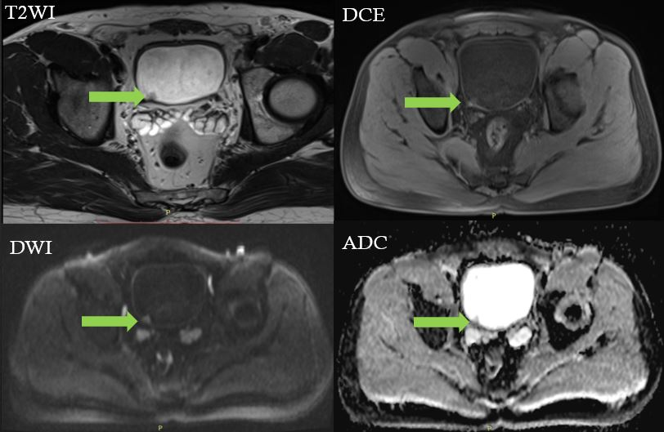
Images
T2 Isointense polypoidal lesion arising from posterior wall of Bladder near right vesicoureteric junction with no interruption of low signal line indicating the integrity of Detrusor muscle & shows no early enhancement of muscle layer
STAGE T1
HPE Proven Low grade Papillary Carcinoma without muscle invasion
Image Credit: Dr. Sree Vandana, Dr. S. Babu Peter, Madras medical college, Chennai

Slide 6
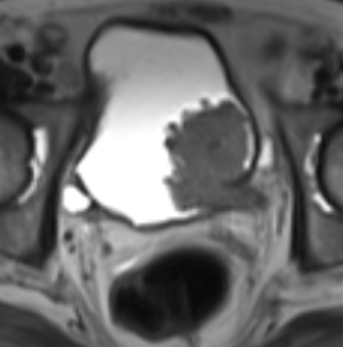
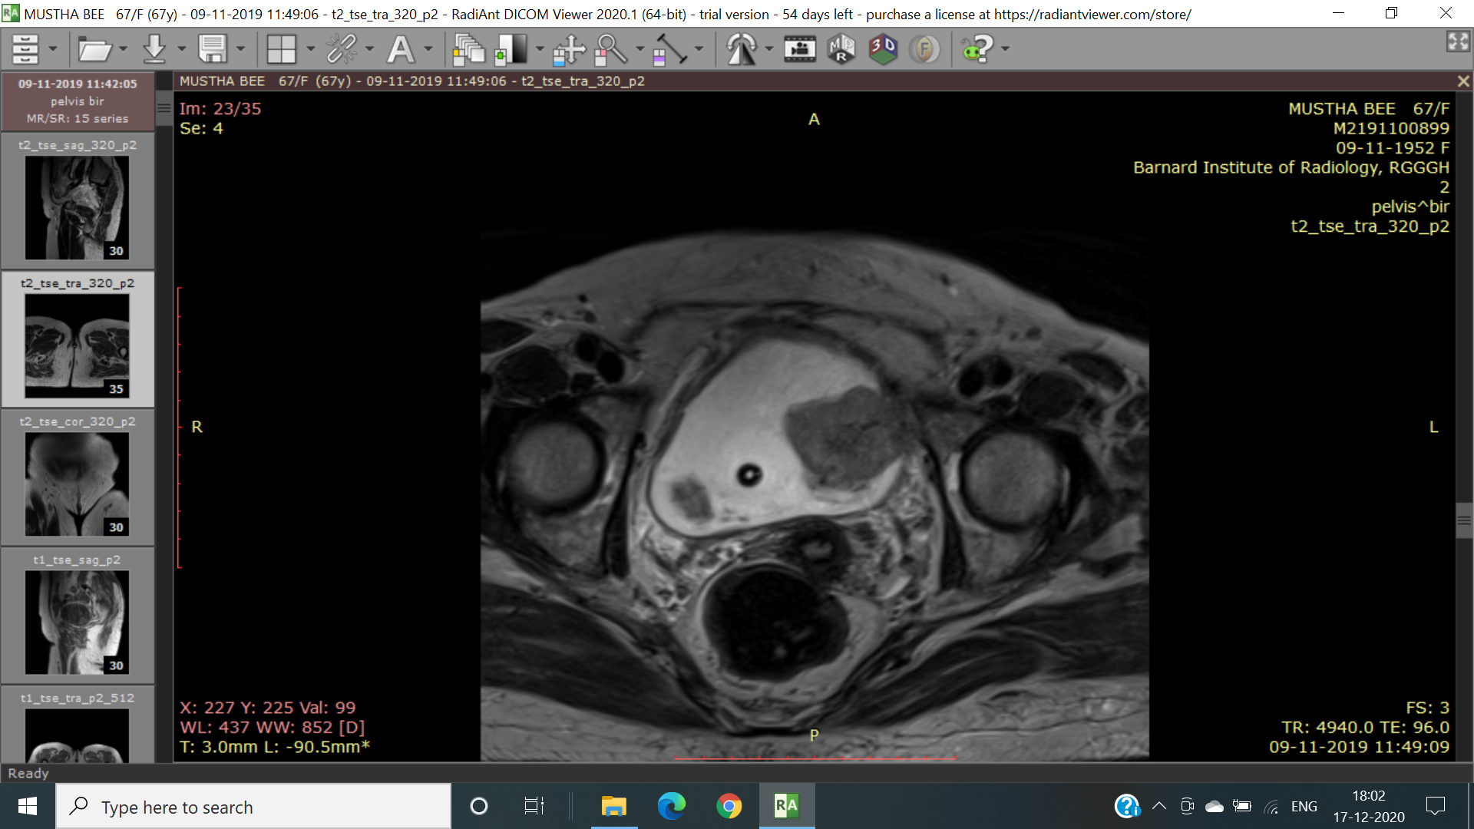
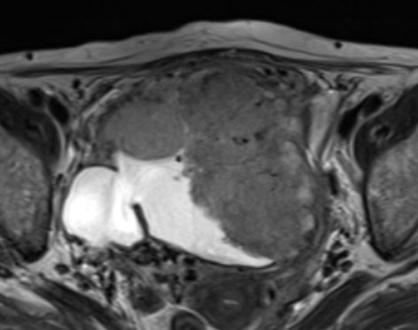
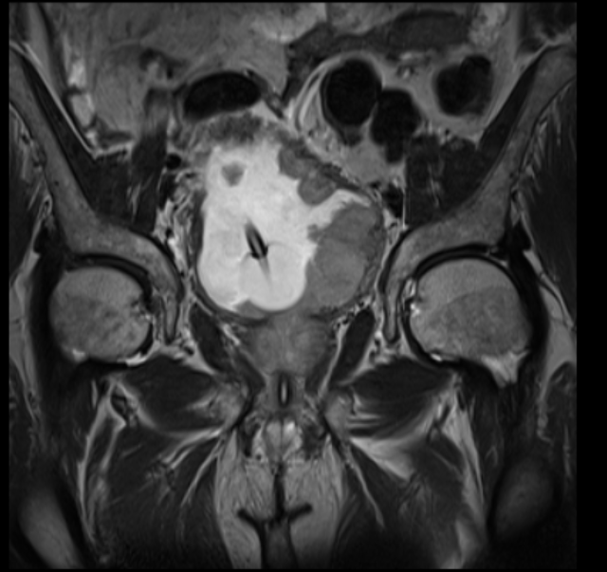
T1
T2
T3
T4
Image Credit: Dr. Sree Vandana, Dr. S. Babu Peter, Madras medical college, Chennai

Slide 7
Discussion
Urothelial tumors are divided into non muscle invasive (80 – 85 % ) & muscle invasive (20 – 25 %) types.
Bladder cancers are categorized according to the TNM system, in which T category represents the degree of bladder wall invasion.
Determining the correct T category is important because it directs treatment decisions.
MRI is considered superior to CT for local staging because of its
High soft-tissue contrast resolution,
Multiplanar imaging capability,
Clearly delineates the layers of the bladder wall,
Accurate assessment of the depth of tumor invasion and extravesical extension.

Slide 8
Conclusion & References
The Introduction of Multiparametric MRI which combines anatomic and functional sequences seems promising in detection & accurate staging of Carcinoma Bladder which aids in optimizing the management.
Hence, Multiparametric MRI can be considered as the appropriate imaging tool in pre-operative staging of Carcinoma Bladder.
1.Robbert J.de Haas, Maarten J. Steyvers and Jurgen J. Futterer. Multiparametric MRI of the Bladder : Ready for clinical Routine?
2.Sadhna Verma, Arumugam Rajesh, Srinivasa R. Prasad et al. Urinary Bladder Cancer :Role of MR Imaging, RSNA

Slide 9
THANK YOU

