Slide 1


MDCT evaluation OF FATTY CHANGES OF LIVER
ABSTRACT ID: PAPER-185
CATEGORY: GIT 107
PRESENTING AUTHOR: Dr. Sudarsan. S
COAUTHORS : Dr. Rohini. A
INSTITUTE: KS Hegde Medical Academy, Mangalore.
FOR PRIZE PAPERS ID , CATEGORY
AND PRESENTOR NAME ONLY

Slide 2

AIMS AND OBJECTIVES
To evaluate different densities of fatty changes of liver on MDCT and to compare with liver function tests.
In this study, we are trying to compare the HU values of liver taken in non contrast, arterial and venous phases with SGOT and SGPT levels of the liver function test.

Slide 3
INTRODUCTION AND BACKGROUND
Fatty liver is excessive accumulation of triglycerides in the hepatocytes and is hepatic manifestation of a number of medical conditions and medications use .
Imaging studies like USG and computed tomography (CT) can show characteristic features of fatty liver but the final diagnosis requires liver biopsy .

Slide 4
NEED FOR THE STUDY

Slide 5
REVIEW OF LITERATURE
Jawarhal A et al performed a study on 200 patients and found out there was statistically significant associations with higher levels of LFTs and fatty liver.
RJ Johnston et al concluded in their study that moderate and severe fatty infiltration were more reliably diagnosed than mild fatty infiltration in CECT.
David A. Lawrence et al conducted a study on 500 patients to assess the sensitivity of CT in diagnosing fatty liver. Their study showed NCCT and CECT shows sensivity of 66 % and specificity of 100%.
In this study, we are trying to compare the HU values of liver taken in non contrast, arterial and venous phases with SGOT and SGPT levels of the liver function test.

Slide 6
MATERIAL
Total- 74 patients (clinically diagnosed based on Hannifin and Chiaia staging system)
Male-43, female-31
Referred from Dept. of physical Medicine & Orthopedics
Exclusion Criteria :
Patients who have received treatment for adhesive capsulitis
Coexisting pathologies, Rotator cuff injuries, active infection.
August 2016 - May 2018
History of trauma and surgery related to onset of adhesive capsulitis

Slide 7
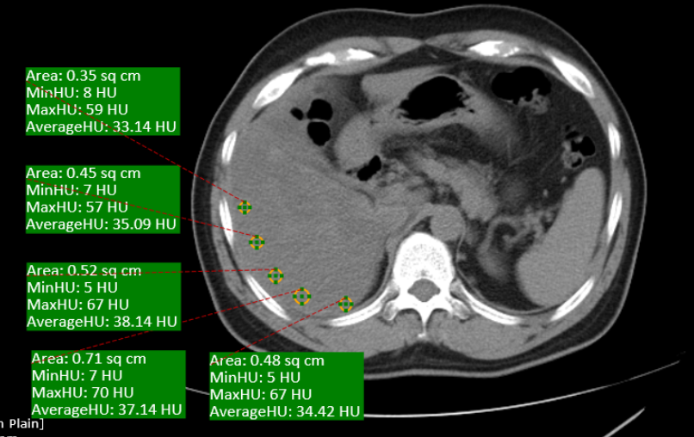
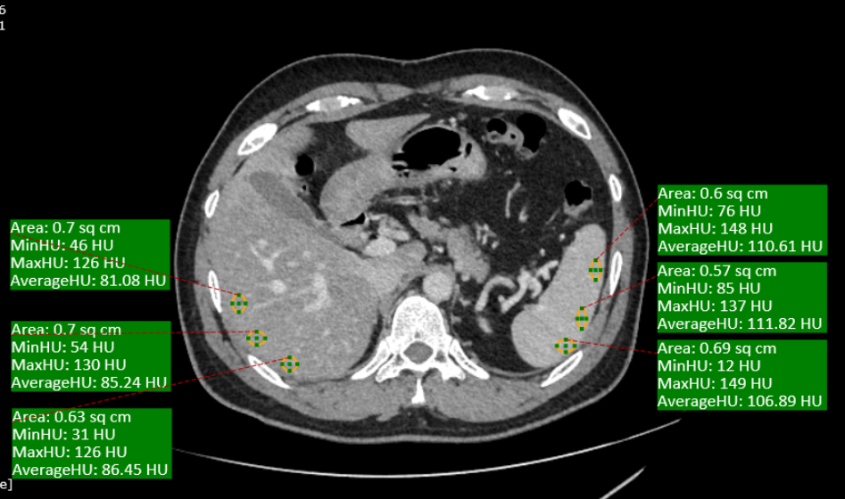
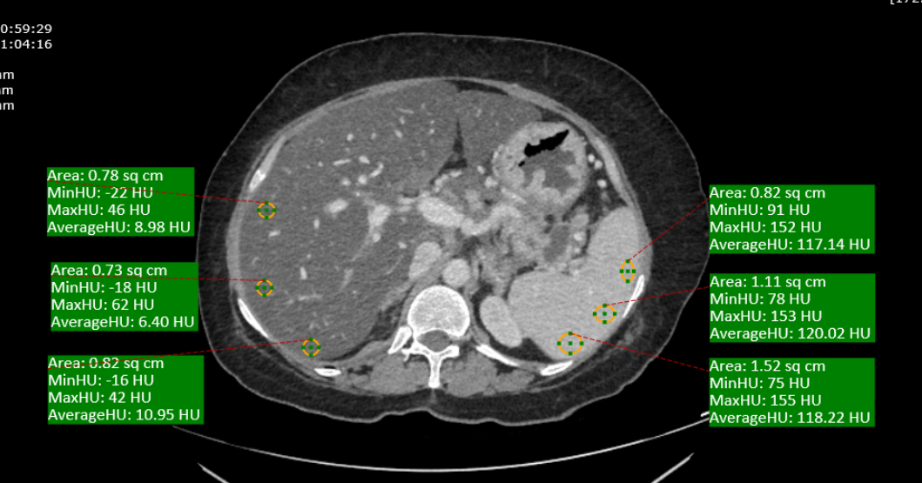
METHODS
CECT axial venous phase image showing that the liver to spleen differenation is that 110 HU indicating severe fatty liver.
Axial venous phase showing the liver to spleen differentiation is more than 10HU suggestive of moderate fatty liver.
Plain CT axial image shows that the average HU values of the liver were falling below 40 HU.

Slide 8
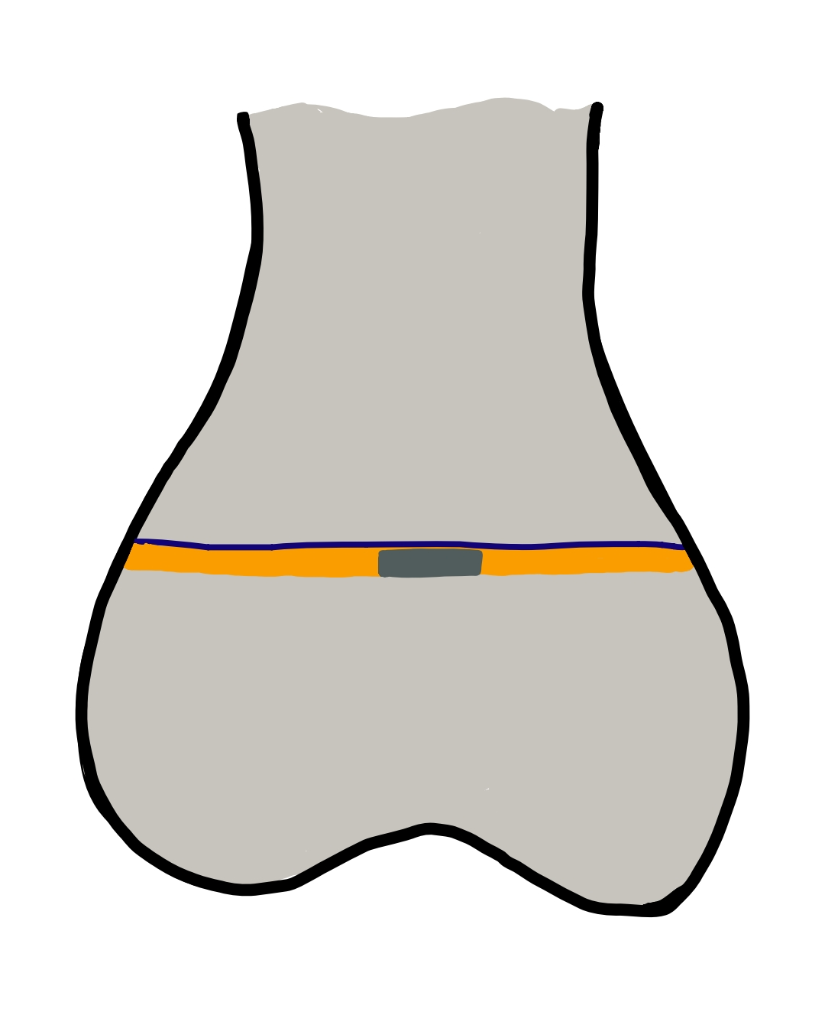
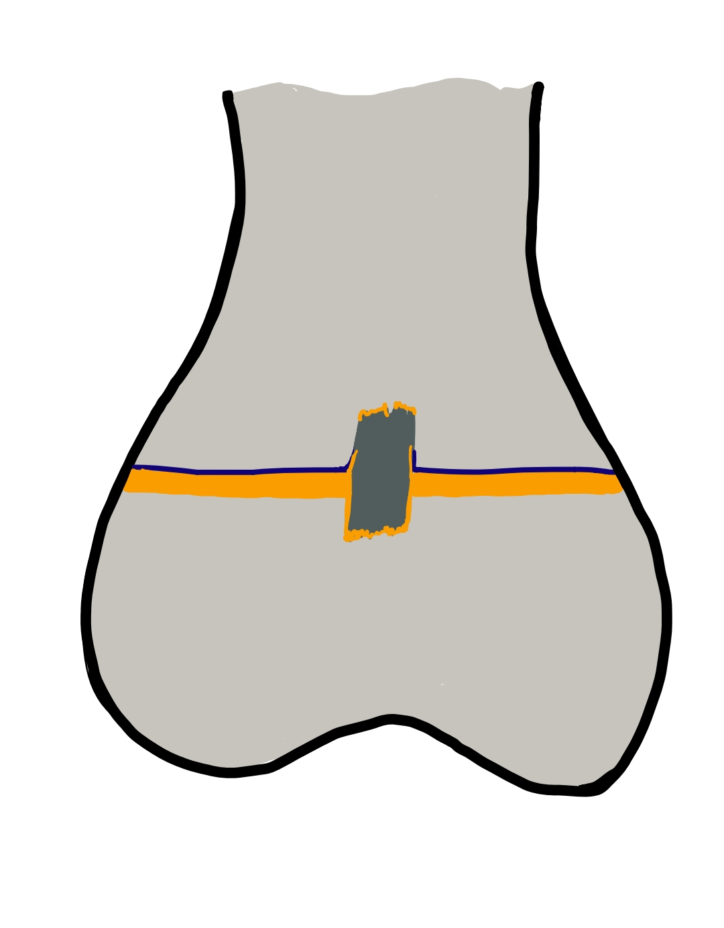
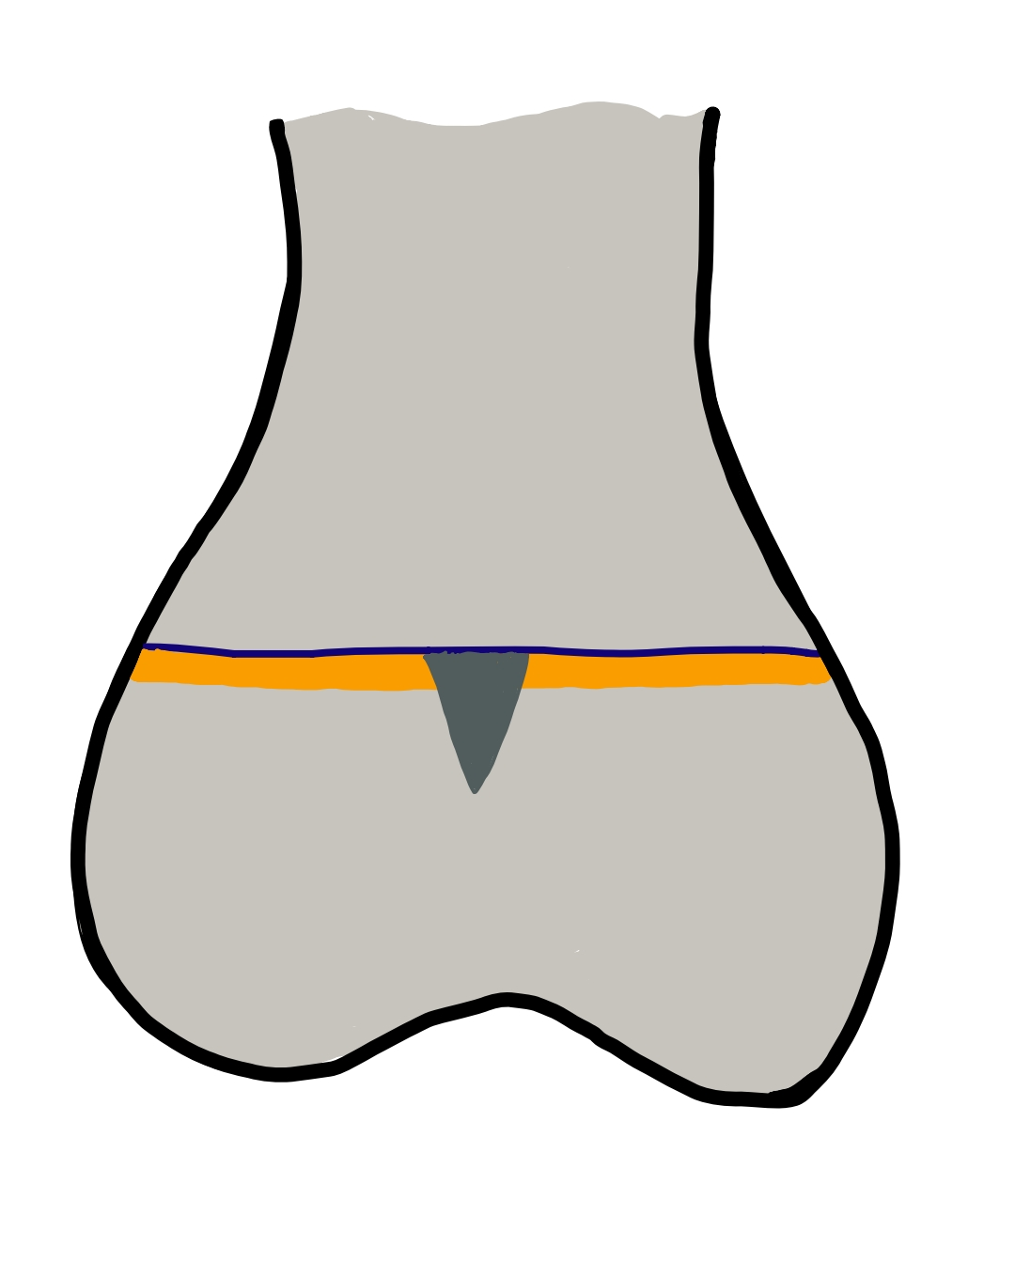
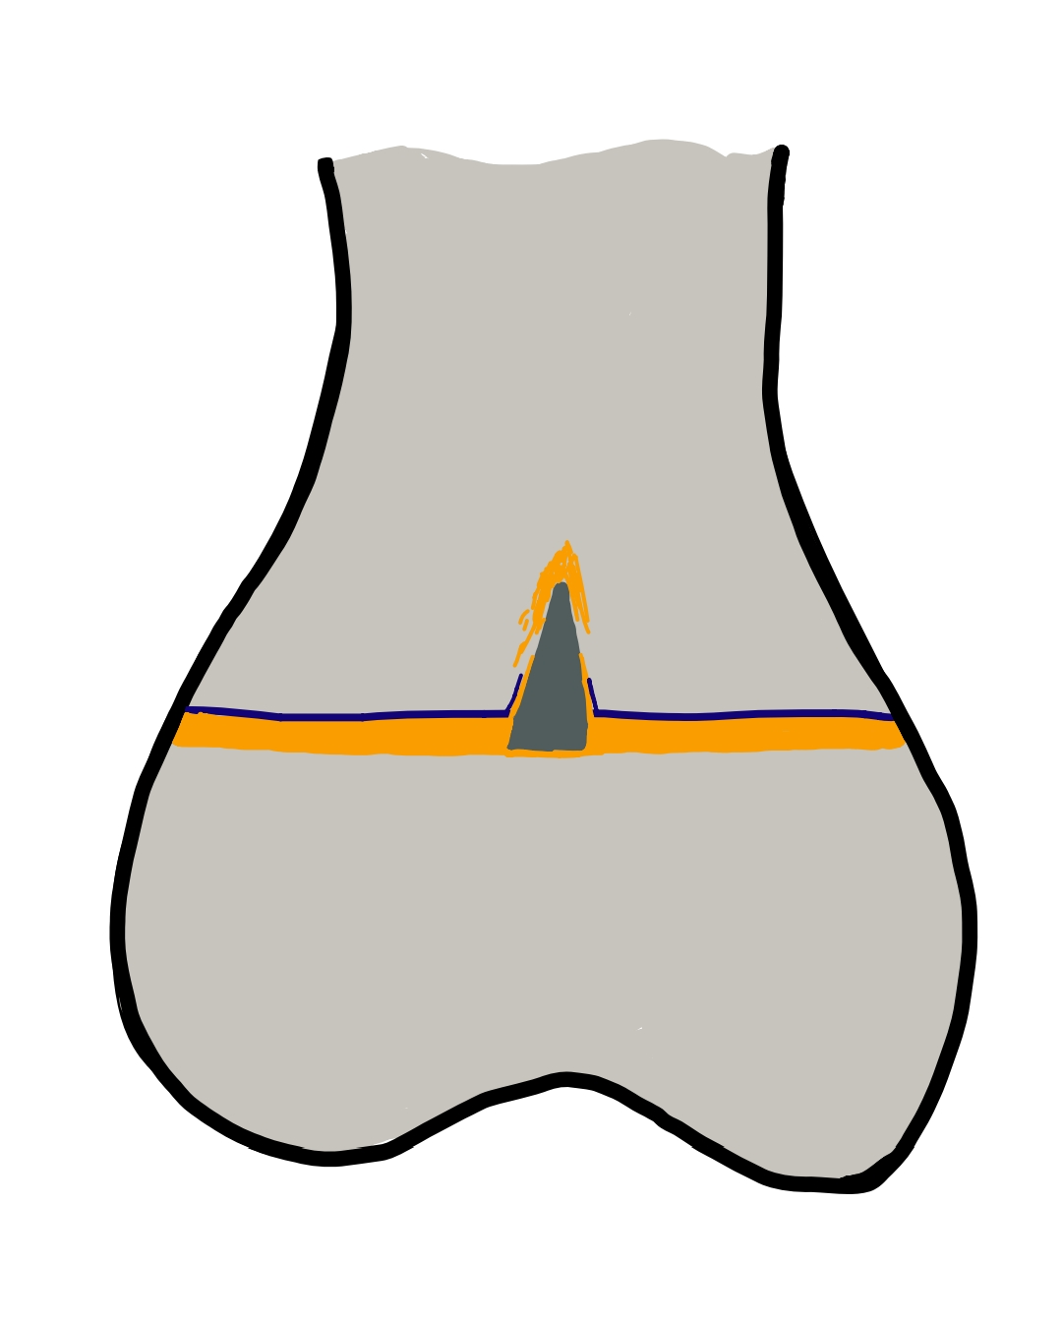
OBSERVATION
Based on extent of involvement ,
Physeal bars could be classified into
Interstitial Physeal
Transphyseal
Metaphyseal
Epiphyseal
a
b
c
d

Slide 9
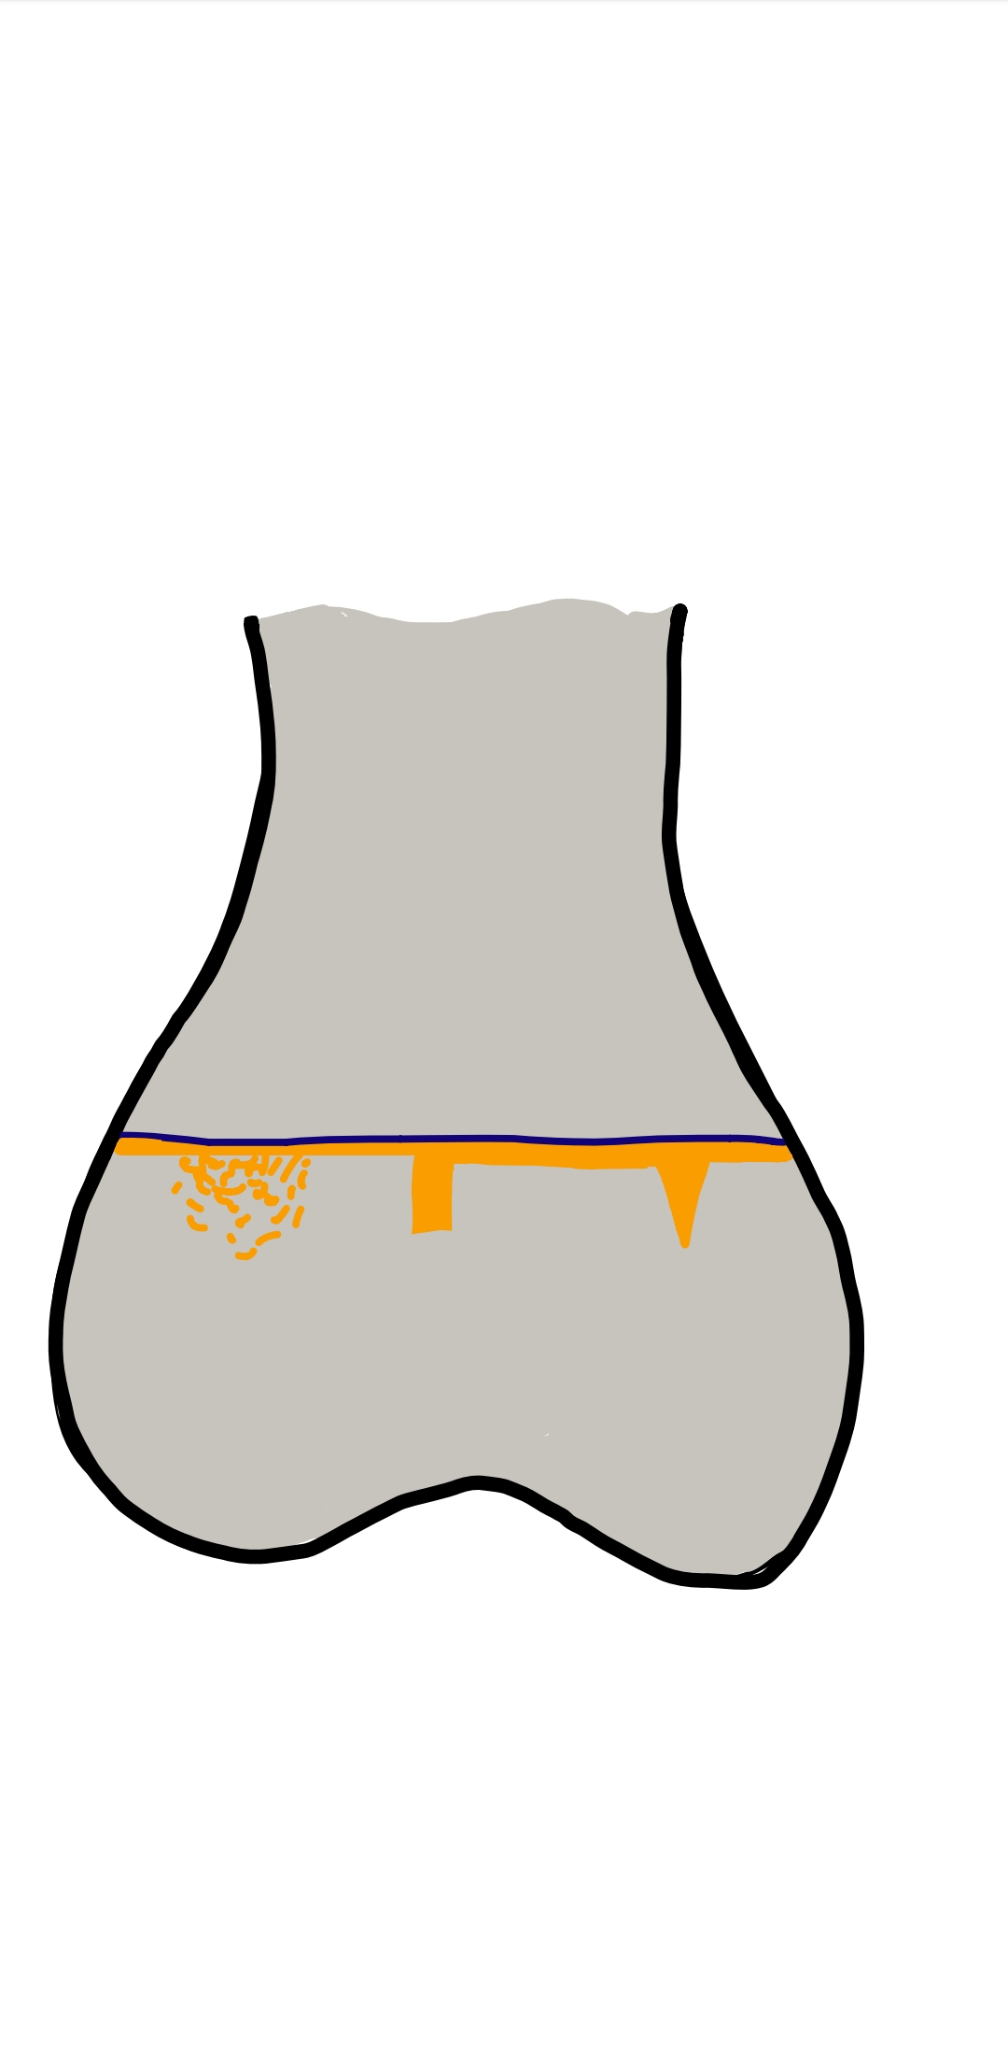
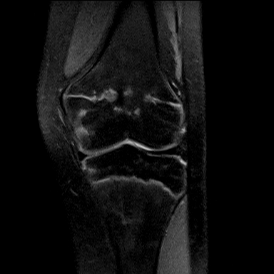
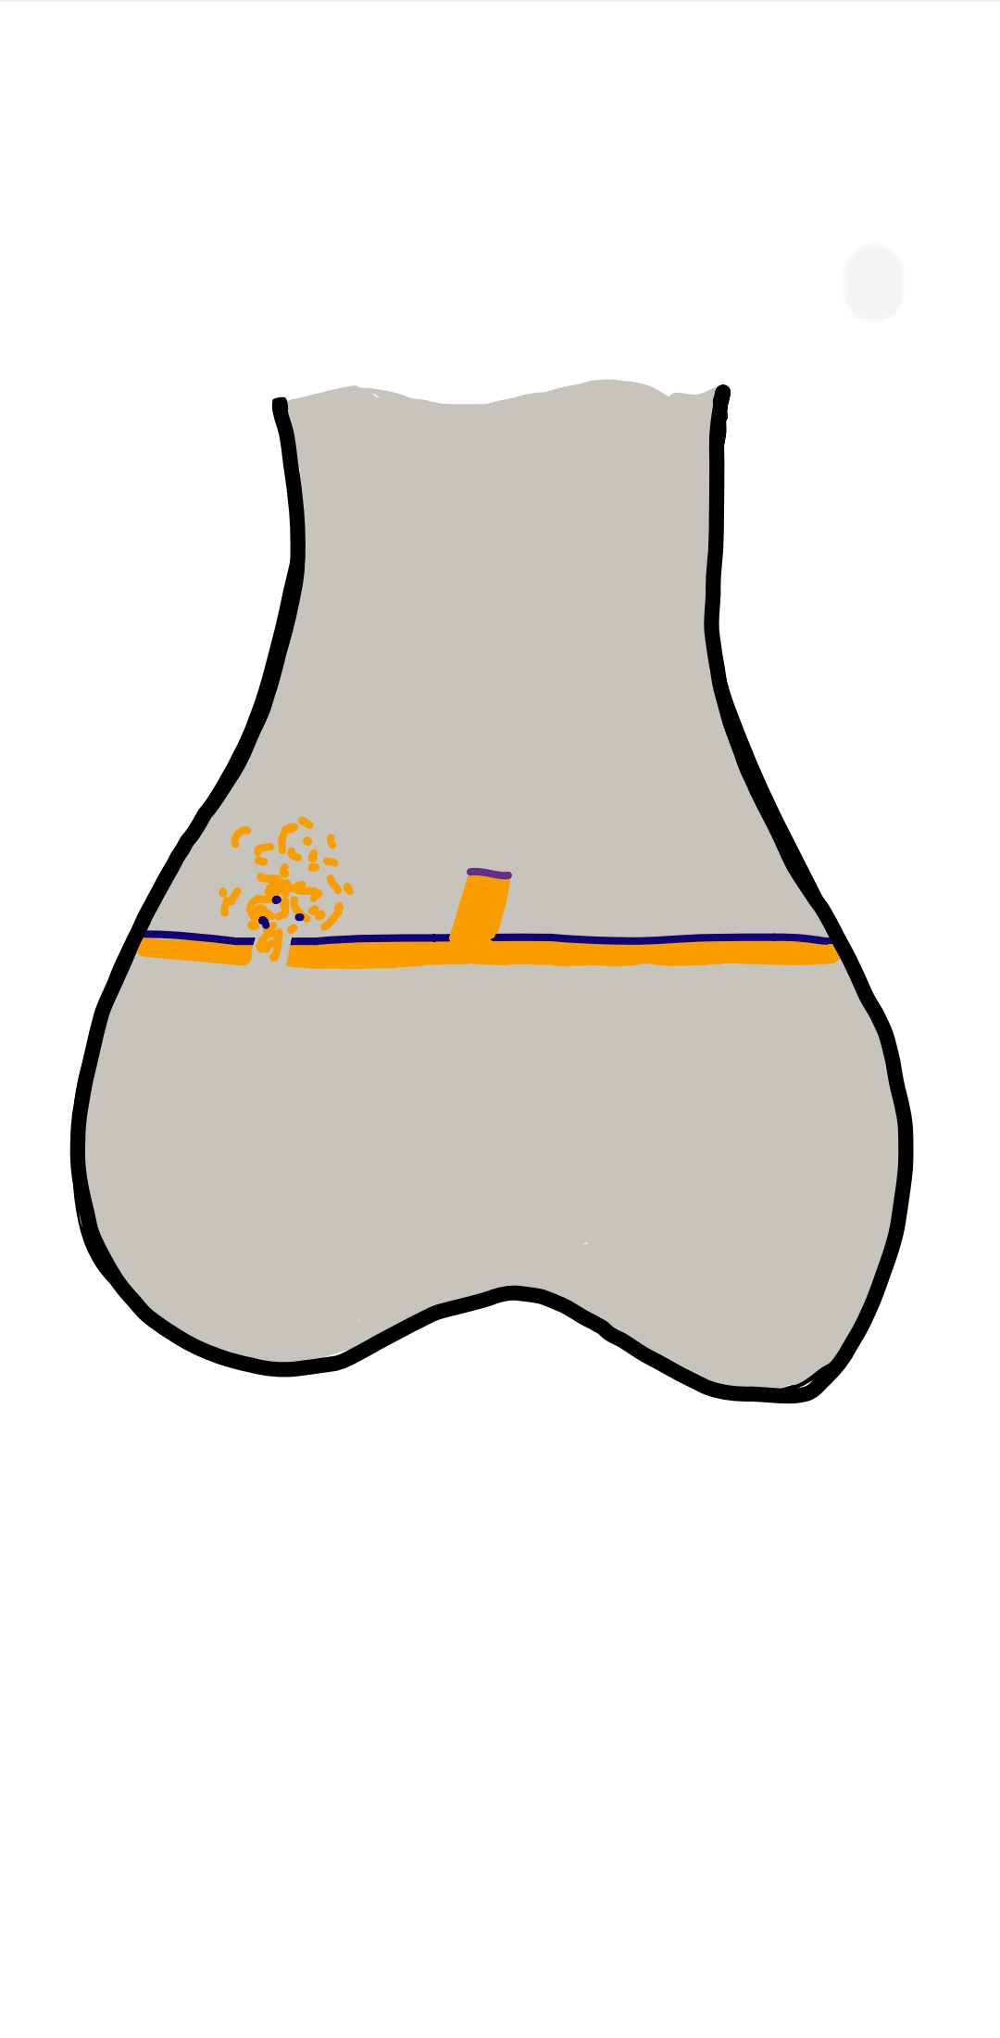
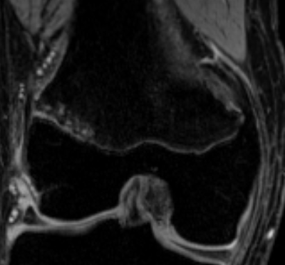
OBSERVATION
EPIPHYSEAL CHONDRAL HERNIATION
METAPHYSEAL CHONDRAL HERNIATION
Cartilage herniation/intrusions occur with physeal insults
They may or may not be associated with physeal bars
Can be an early predictor of site of bar formation and are thought to be a precursor of a physeal bar

Slide 10
ANALYSIS & RESULTS
Out of 100 patients, 61 are men and 39 are women.
21 patients are in 20 – 30 years age group, 37 patients are in 31 – 40 age group and 42 pateints are in 41 – 50 age group.
NCCT
CECT
Severity | LFT | Abnormal LFTs | Total
 | Normal | Abnormal
Mild (31-40HU) | 15 | 8 | 23
Moderate (21-30 HU) | 17 | 10 | 27
Severe (<20HU) | 3 | 15 | 18
TOTAL | 35 | 33 | 68
Severity | LFT |  | Total
 | Normal | Abnormal
Mild (21-40 HU diff) | 22 | 9 | 31
Moderate (41-60 HU diff) | 9 | 21 | 30
Severe (>60HU diff) | 2 | 12 | 14
TOTAL | 33 | 42 | 75
- | NCCT | CECT
sensitivity | 70% | 81%
specificity | 35.2% | 31%

Slide 11
FINDINGS AND PROCEDURE DETAILS
Our study revealed both NCCT and CECT helps in the diagnosis of fatty liver in the earlier stages.
Also patients with severe fatty liver were showing significant deranged LFTs.

Slide 12
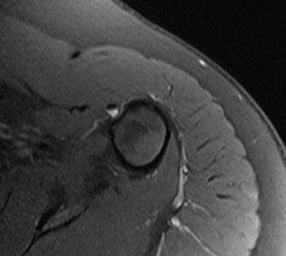
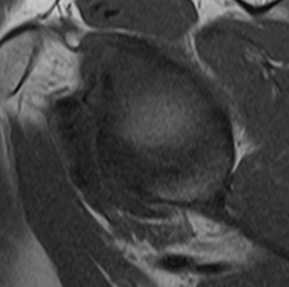
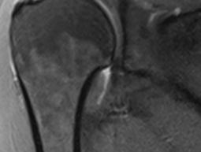
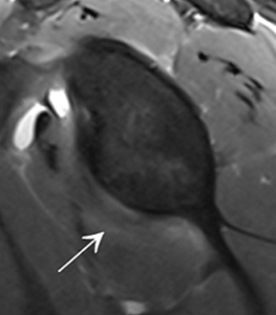
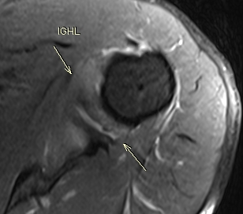
CASE 1
48/M
CLINICAL DIAGNOSIS- ADHESIVE CAPSULITIS STAGE 1
Thickened IGHL
Fluid around Biceps tendon
Joint space edema
Anterior pericapsular edema
Thickened axillary pouch & anterior band

Slide 13
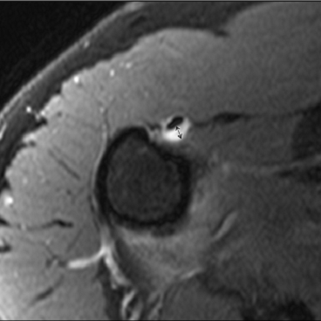
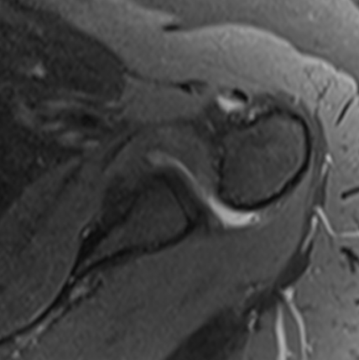
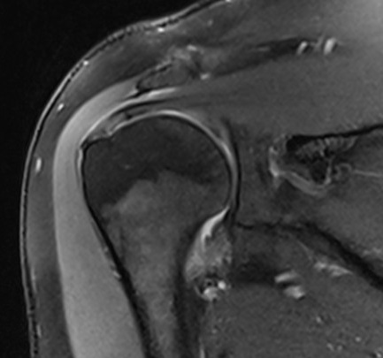
CASE 2
55 /M
CLINICAL DIAGNOSIS- ADHESIVE CAPSULITIS STAGE 2
EDEMA OF INFERIOR GLENOHUMERAL LIGAMENT
THICKENED ANTERIOR BAND OF IGHL- 7.5mm(H)&6.2mm(G)

Slide 14
DISCUSSION
Obliteration of fat outside the subcoracoid triangle was also found more frequently in stages IV and III which relates to the ongoing fibrosis and scar formation.
Distribution of edema of the IGHL , anterior and posterior pericapsular edema (more in stage I and II and less in stage III and nil in stage IV) also significantly correlated with the clinical stages.
The age of the patient, fluid around the biceps tendon, thickness of the axillary pouch on the glenoid aspect, height and width of the axillary pouch, thickness of the coracohumeral ligament did not show any significant variation between the stages
Limitation of our study is that the progression of the disease in all patients could not be followed up due to ongoing treatment.

Slide 15
LIMITATIONS
The study group was small due to rarity of the condition.
Earlier imaging and follow up were not taken into account.
Acute OBPI patients were not included in this study.
Since only the children presenting to hospital with subluxation/dislocation were included in this study, presubluxation stage (varying severity of nerve injury like neuropraxia / neurotemesis) could not be assessed by our study.

Slide 16
CONCLUSION
CT scans have proven to be useful in diagnosing the presence and quantifying the severity of liver fat noninvasively.
The Hounsfield Unit (HU) attenuation of liver on CT scans is usually higher than the spleen; when this ratio is reversed, this can be used to diagnose the presence of liver fat .

Slide 17
OUTCOME /CLINICAL APPLICATIONS
NCCT and CECT is a non invasive procedure and can be used in the diagnosis of fatty liver in all the patients.
Also in patients who are asymptomatic, CT helps in incidental pick up of the fatty liver and aids in the further management of the patients at an early stage.

Slide 18
REFERENCES
Zeb I, Li D, Nasir K, Katz R, Larijani VN, Budoff MJ. Computed tomography scans in the evaluation of fatty liver disease in a population based study: the multi-ethnic study of atherosclerosis. Acad Radiol. 2012 Jul;19(7):811-8. doi: 10.1016/j.acra.2012.02.022. Epub 2012 Apr 21. PMID: 22521729; PMCID: PMC3377794.
Jawahar A, Gonzalez B, Balasubramanian N, Adams W, Goldberg A. Comparison of correlations between lipid profile and different computed tomography fatty liver criteria in the setting of incidentally noted fatty liver on computed tomography examinations. Eur J Gastroenterol Hepatol. 2017 Dec;29(12):1389-1396. doi: 10.1097/MEG.0000000000000972. PMID: 28957871.
Johnston RJ, Stamm ER, Lewin JM, Hendrick RE, Archer PG. Diagnosis of fatty infiltration of the liver on contrast enhanced CT: limitations of liver-minus-spleen attenuation difference measurements. Abdom Imaging. 1998 Jul-Aug;23(4):409-15. doi: 10.1007/s002619900370. PMID: 9663278.

Slide 19
THANK YOU

