Slide 1


Wiring the route : Decoding the perineural spread in head and neck tumors
Abstract ID:
Presenting author:

Slide 2
LEARNING OBJECTIVES
Clinical & Imaging concepts of perineurial spread
Cranial nerve anatomy
MRI /CT protocol
MRI/CT signs of perineural spread
Common malignancies
Case studies with Radpath correlation

Slide 3

BACKGROUND
Growth along nerves - A distinctive feature of head and neck maliganancies - occurs in 2 forms : Perineural tumour spread (PNS/PNTS) and Perineural invasion/ infiltration (PNI)
PNS and PNI - pathologically distinct entities, but often indistinguisable on imaging, hence used interchangebly in literature
PNS → Extension of tumour along a nerve, and may reach a significant distance from primary lesion site, most frequently along trigeminal (maxillary, mandibular) and facial nerves
PNI → Neoplastic infiltration of a nerve at original tumour sit
Imaging plays critical role in assessment of PNS/PNI in head and neck tumours

Slide 4
PNS/PNI in Head and Neck Cancers: Histologic Types
Clinical presentation
Squamous cell carcinoma (SCCA) both mucosal and cutaneous - Most prevalent histologic subtype - accounting for largest number of cases of PNS/PNI
Higher rates of PNS/PNI (2%–30%) seen in mucosal SCCA of oral cavity, hypopharynx and larynx, compared to cutaneous origin
Adenoid cystic carcinoma of minor and major salivary gland - Highest association with PNS (up to 50 - 60%)
Mucoepidermoid carcinoma of salivary glands - high association with PNS
Cutaneous malignancy-Basal cell carcinoma and Melanoma (desmoplastic variant)
Lymphoma - Usually advanced cases of NHL
Rhabdomyosarcoma
Inflammatory myofibroblastic tumour (IMT)
PNS - asymptomatic in 30 - 40% of patients with radiographic evidence of disease
Symptoms are specific to PNS in a particular cranial nerve distribution
CN V and branches → facial pain, burning, formication or numbness
CN VII → facial weakness and droop
Mandibular nerve (V3) → difficulty chewing
CN XII → tongue atrophy
CN X → vocal cord paralysis
Imaging modalities
CECT - better for delineationof involvement of bone and neural foraminal widening/erosion
CEMRI - Modality of choice for direct demonstration of PNS and PNI
T1 fat saturated contrast enhanced MRI images - best for evaluation of PNTS
FDG-PETCT- Useful for distant metastatic PNS

Slide 5
Imaging Findings of Perineural spread
Direct signs
Indirect signs
Diffuse or nodular thickening/ enlargement of nerve
Enhancement of nerve
Widening/ enlargement of neural foramina
Bony erosion/ destruction at foramina
Obliteration of juxtraforaminal fat plane/fat pad
Intracranial spread through skull base
Denervation atrophy in supplied muscles (in chronic phase)
Change in signal and enhancement in supplied muscles
Denervation edema [T1 - hypo, T2/T2FS - hyper] and post contrast enhancement in muscles (in acute or subacute phase < 1 month)
Atrophy with fatty replacement [T1- hyper, T2 - hyper] in muscles (in chronic phase > 6 months)

Slide 6

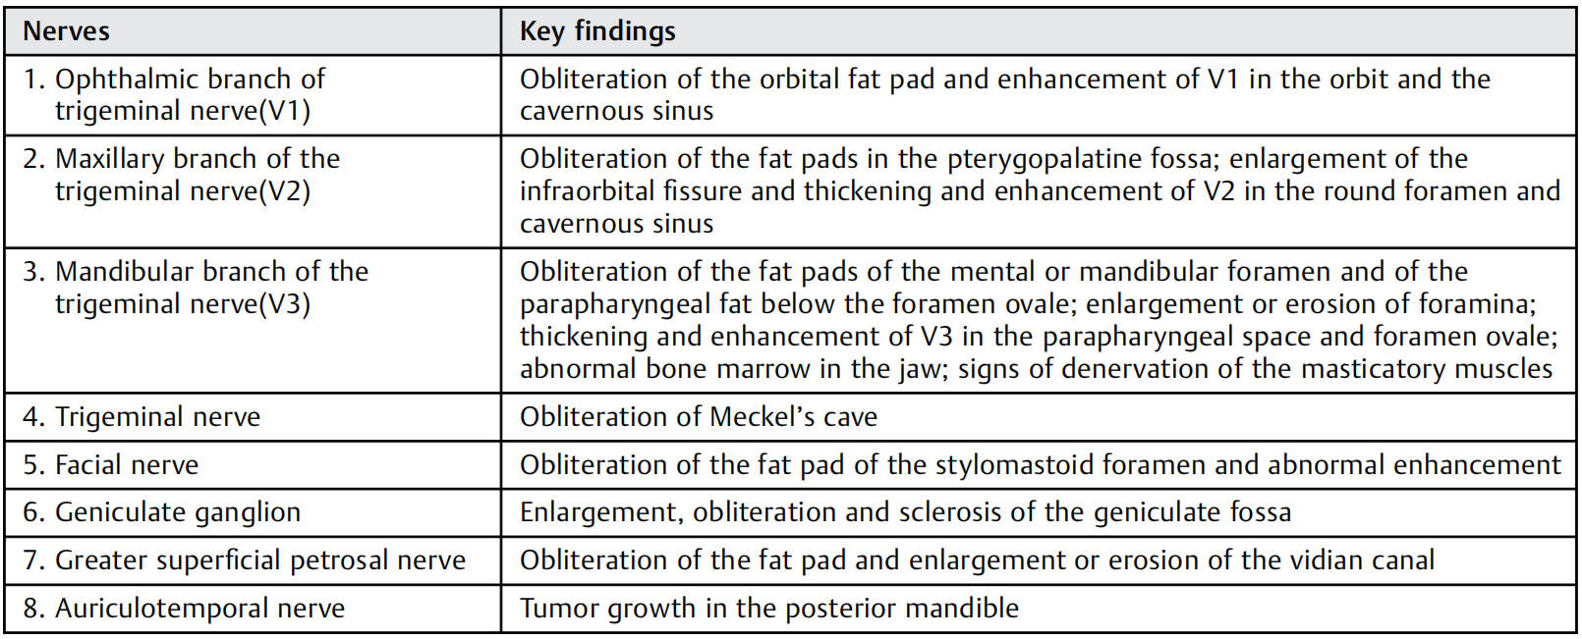
Key points in evaluation of each nerve for
PNS/PNI
Ref - Mahajan A, Agarwal U, PG N. Imaging Recommendations for Diagnosis, Staging, and Management of Oral Cancer. Ind J Med Paediatr Oncol 2023;44:150–158.

Slide 7
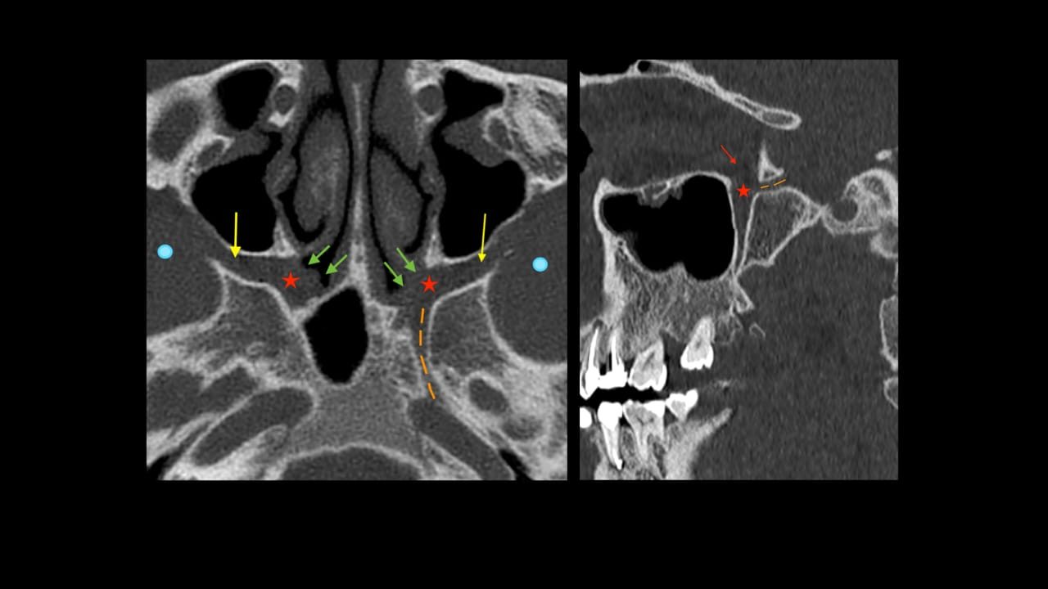
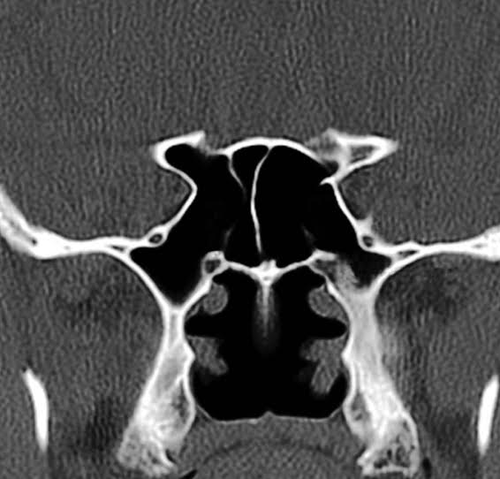
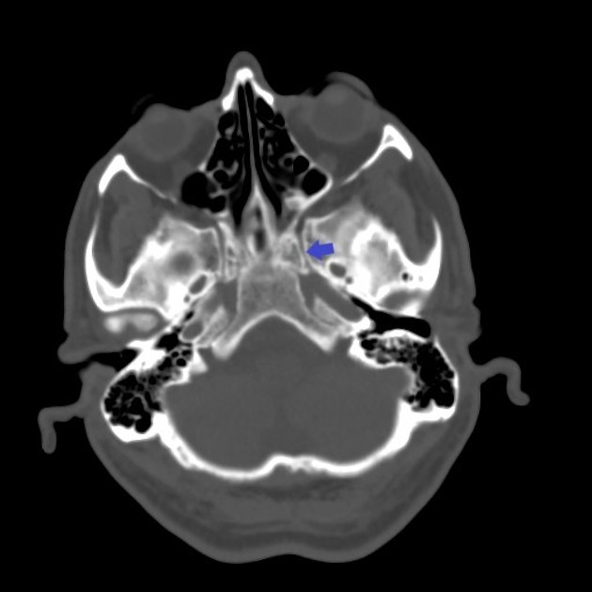
Normal structures evaluated for PNS
Pterygomaxillary fissure
Pterygoplatine fossa
Sphenopalatine foramen
VIDIAN CANAL
Infratemporal fossa
Pterygoplatine fossa
FORAMEN SPINOSUM
PPF comminucates with foramen lacerum via vidian canal
FORAMEN OVALE

Slide 8

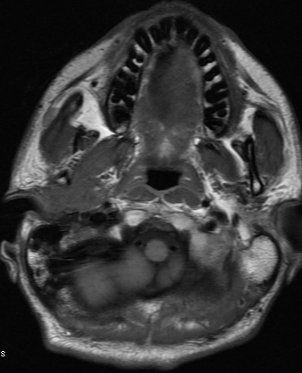
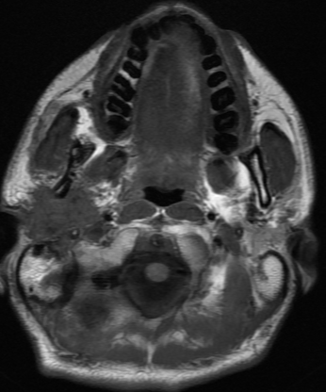
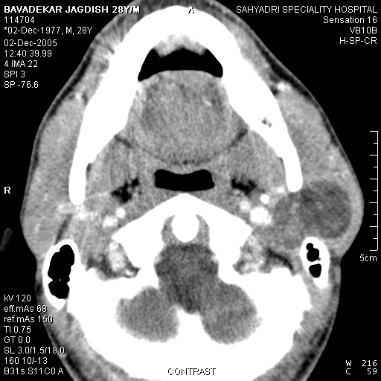
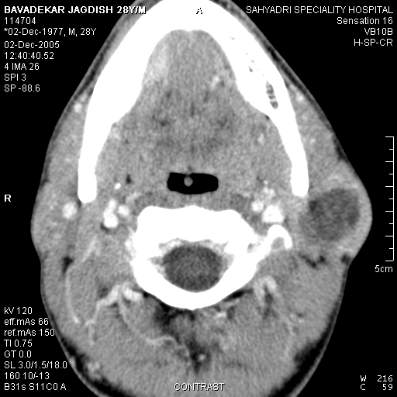
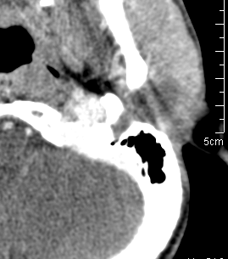
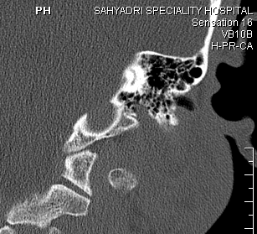
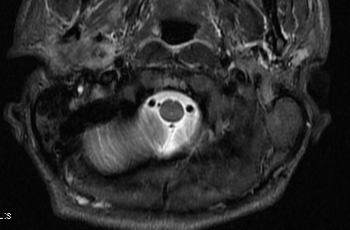
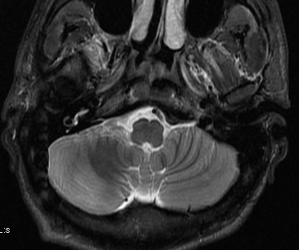
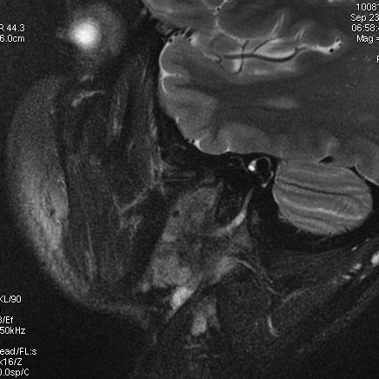
CASE 1
CASE 2
Heterogenous enhancing solid lesion (arrow) –right parotid gland with features of Perineural tumour spread along auriculotemporal nerve which has connection with facial nerve in parotid- which shows neural enhancement( )
Hetergenous lesion (star) in left parotid gland causing perineural spread along facial nerve causing widening of sylomastoid foramen (arrow)

Slide 9
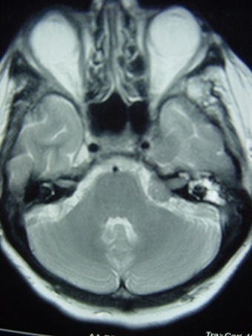
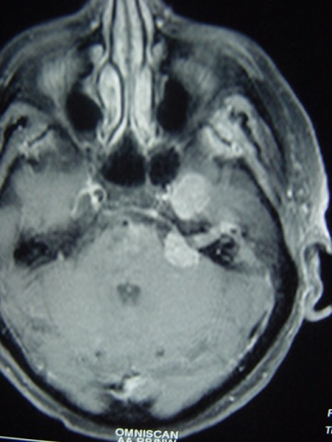
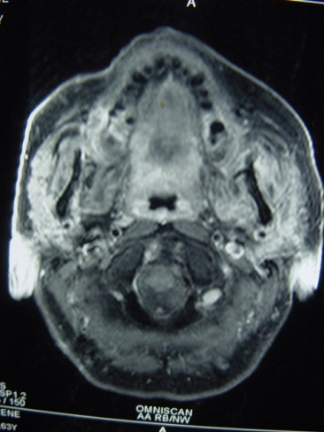
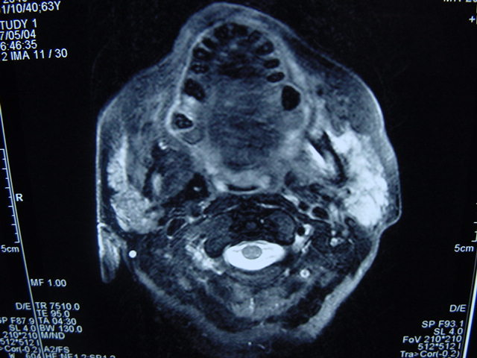
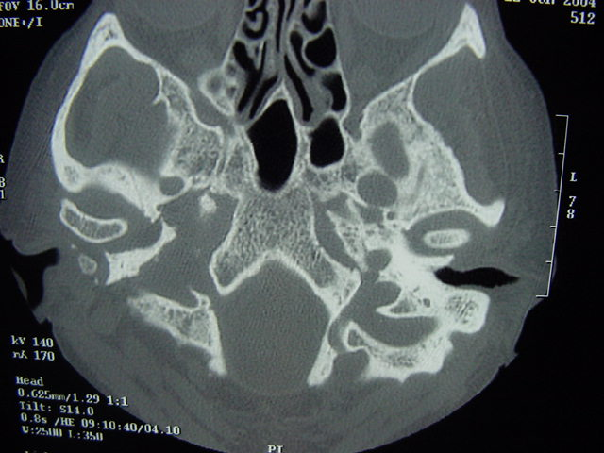
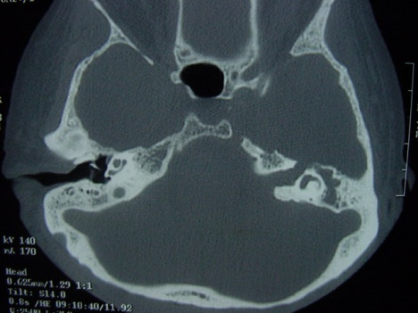
Case 3
62 year old with Left facial weakness – non resolving for 18 months
Open biopsy showed- Mucoepidermoid carcinoma of the parotid with perineural invasion
Perineural spread (VII, V3) of a malignant parotid tumour invading masticator space / auriculotemporal nerve – V3 and VII invasion, showing neural enhancement in MRI and CT showed widening of the foramen ovale

Slide 10

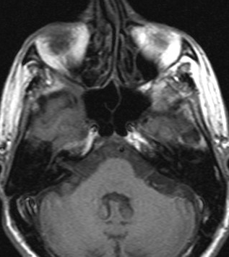
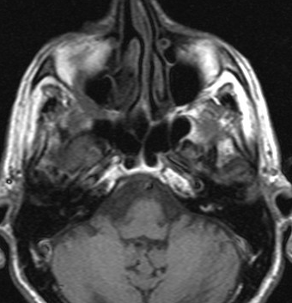
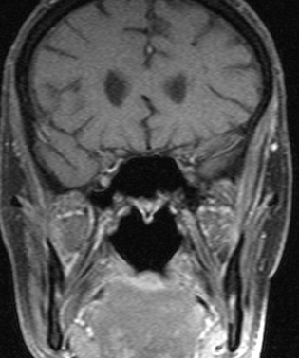
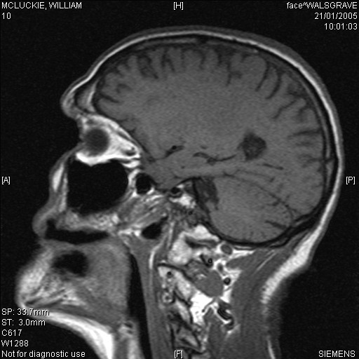
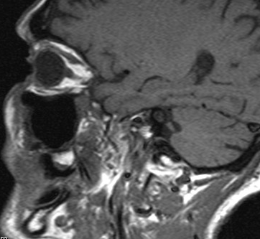
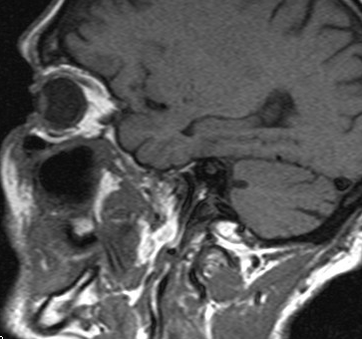
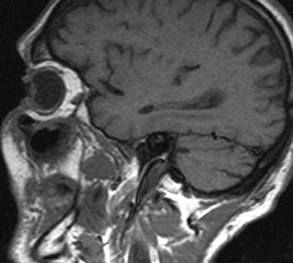
Case 4
78/M with increasing numbness of the right cheek, Clinical examination unremarkable apart from a tiny reddish lesion .Reduced sensation of the right cheek.No neck nodes. Biopsy of the tiny ‘reddish’ lesion – Sq cell carcinoma
Perineural enhancement along the Infraorbital nerve -reaching PPF . MRI sign: Loss of fat at PPF/ PMF/ Rotundum

Slide 11
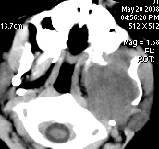
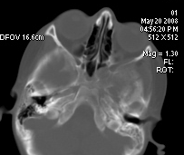
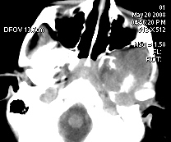
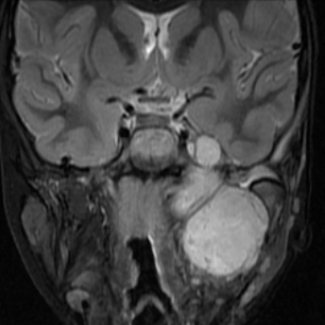
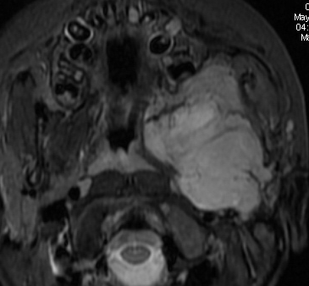
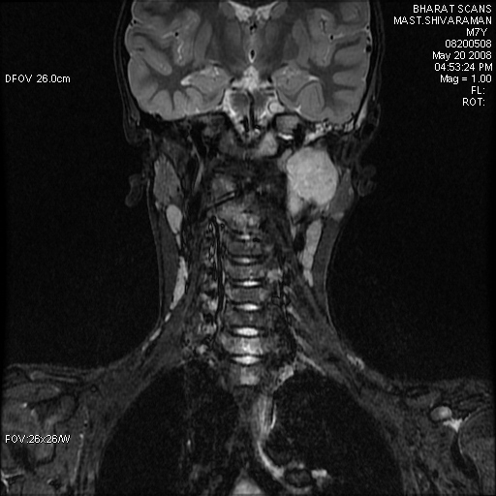
CASE 5
7 year old boy presented with swelling in the left cheek. Embryonal Rhabdomyosarcoma with intracranial extension and metastasis.
Poorly defined infiltrative mass (star) - rhabdomyosarcoma involving left masticator space with bony erosion of mandible and pterygoid plates. Perineural spread along

Slide 12
CONCLUSION
Radiologists should be familiar with the pattern of growth and spread in various head and neck malignancies especially the perineural tumour spread patterns, with good knowledge of key antomical landmarks for detection of PNS, their radiologic appearance and clinical significance for optimal patient management.

Slide 13
TEACHING POINTS
Patient with any head and neck malignancy-
Get the MRI protocol right to detect perineural spread… (contrast MRI+MP)
Look closely the nerve course for the signs & Follow the nerve anatomy.
Use CT to add confidence and confirmation of bone related changes
Any patient with trigeminal nerve symptoms – facial pain/numbness
Look out and trace the divisions of V nerve from face/orbit to the brain stem
Radiologist can be the first person to detect the malignancy in such symptoms and also detect Perineural spread
MRI –Gold standard imaging modality.

Slide 14
REFERENCES
Maroldi R, Farina D, Borghesi A, Marconi A, Gatti E. Perineural tumor spread. Neuroimag Clin N Am. 2008;18:413–29.
Chang PC, Fischbein NJ, McCalmont TH, et al. Perineural spread of malignant melanoma of the head and neck: clinical and imaging features. AJNR Am J Neuroradiol. 2004;25:5–11. [PMC free article] [PubMed] [Google Scholar]

Slide 15

Thank you

