Slide 1

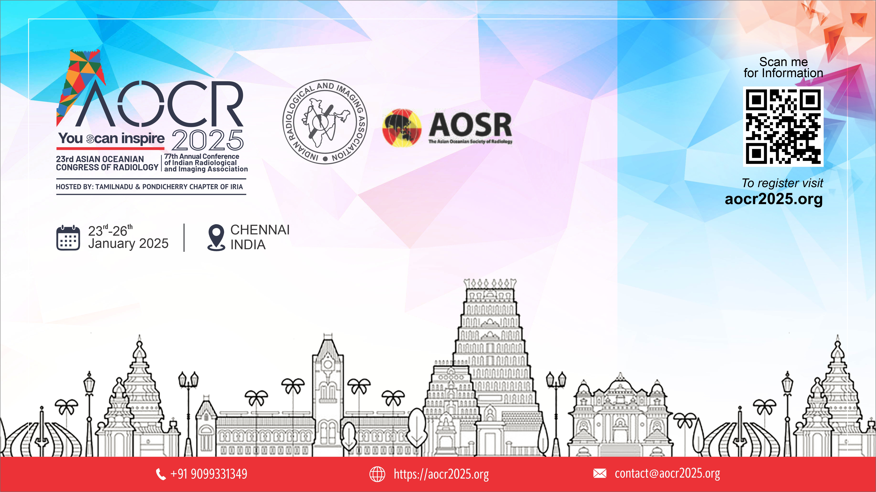
ADD THEME, DATE
Title
(FETAL INTERVENTIONS)
Abstract ID:
Presenting author:

Slide 2
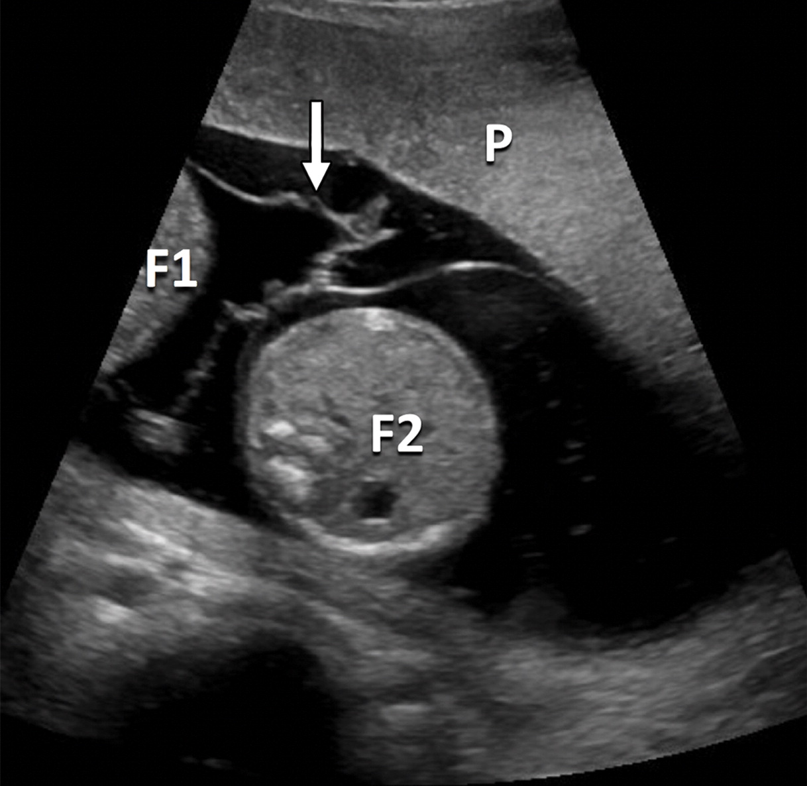
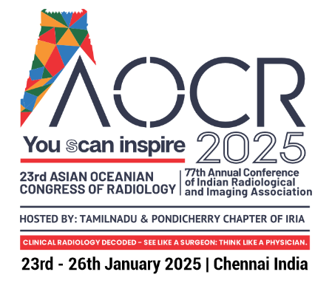
STATUS POST LASER PHOTOCOAGULATION FOR TTTS. IDENTIFY THE COMPLICATION
Case Credit: Dr. G. K. Vidhyalakshmi, Dr. C. Amarnath, Stanley medical college, Chennai.

Slide 3
SEPTOSTOMY
Disruption of intertwin membrane of MCDA twin complicated by septostomy post laser photocoagulation results in rapid equalisation of amniotic fluid in both sacs.
Case Credit: Dr. G. K. Vidhyalakshmi, Dr. C. Amarnath, Stanley medical college, Chennai.

Slide 4
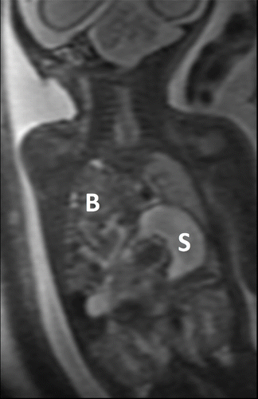
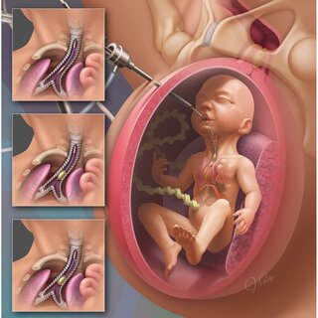
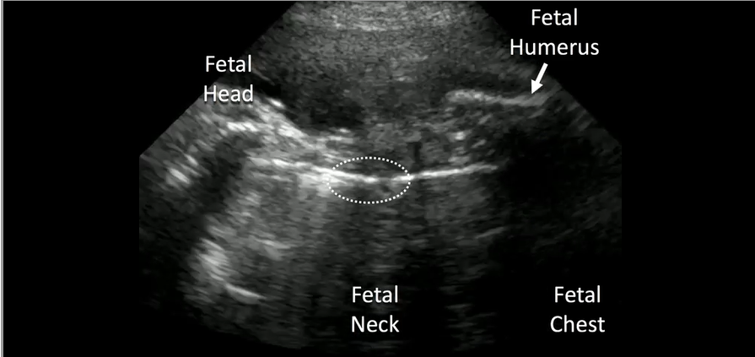
IDENTIFY THE ANOMALY AND THE INTERVENTION DONE FOR IT
Case Credit: Dr. G. K. Vidhyalakshmi, Dr. C. Amarnath, Stanley medical college, Chennai.

Slide 5
CONGENITAL DIAPHRAGMATIC HERNIA- FETOSCOPIC ENDOLUMINAL BALLOON TRACHEAL OCCLUSION
Herniation of stomach, bowel and liver into the fetal chest.
Prenatal fetoscopic endoluminal tracheal occlusion is the treatment of choice for CDH and involves insertion of a temporary occlusive balloon device into the fetal trachea. Tracheal occlusion leads to accumulation of lung secretions, which in turn promotes lung expansion and development and maturation of the fetal lung.
Case Credit: Dr. G. K. Vidhyalakshmi, Dr. C. Amarnath, Stanley medical college, Chennai.

Slide 6
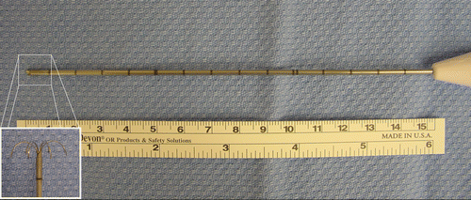
IDENTIFY THE INSTRUMENT
Case Credit: Dr. G. K. Vidhyalakshmi, Dr. C. Amarnath, Stanley medical college, Chennai.

Slide 7
RADIOFREQUENCY ABLATION DEVICE
RFA for selective fetal reduction in monochorionic twin pregnancies complicated by twin reversed arterial perfusion (TRAP) sequence or a compromised fetus with impending fetal death (a lethal anomaly or early severe intrauterine growth restriction).
Case Credit: Dr. G. K. Vidhyalakshmi, Dr. C. Amarnath, Stanley medical college, Chennai.

Slide 8
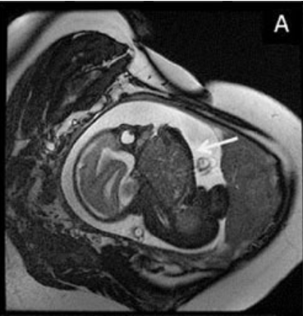
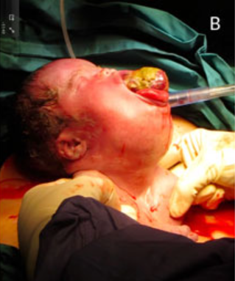
IDENTIFY THE PROCEDURE
Case Credit: Dr. G. K. Vidhyalakshmi, Dr. C. Amarnath, Stanley medical college, Chennai.

Slide 9
EXIT PROCEDURE FOR ORAL TERATOMA
The ex utero intrapartum therapy (EXIT) procedure is used to secure the fetal airway before complete delivery of the fetus, in anticipated fetal airway compromise at birth in cases of cervical and oropharyngeal tumors.
Case Credit: Dr. G. K. Vidhyalakshmi, Dr. C. Amarnath, Stanley medical college, Chennai.

Slide 10
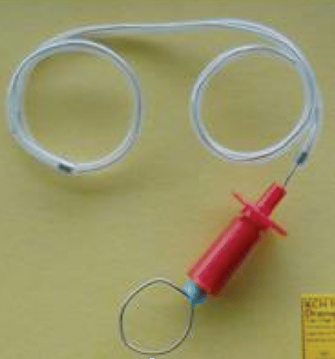
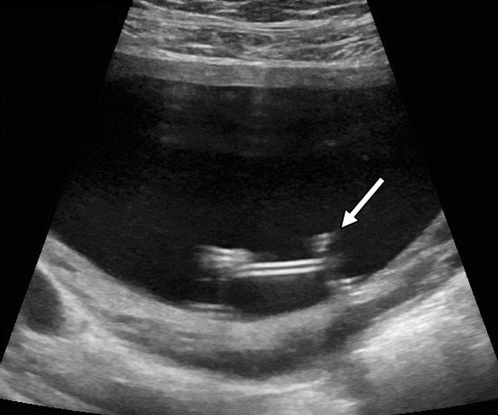
IDENTIFY THE DEVICE AND THE COMPLICATION
Case Credit: Dr. G. K. Vidhyalakshmi, Dr. C. Amarnath, Stanley medical college, Chennai.

Slide 11
DISPLACED VESICO-AMNIOTIC SHUNT INTO THE AMNIOTIC CAVITY
Decompression of obstructed urinary system with vesicocentesis/ vesicoamniotic shunt/ mechanical dilatation / ablation of posterior urethral valve. The shunt can dislodge into the amniotic cavity/ fetal abdomen causing urinary ascites.
Case Credit: Dr. G. K. Vidhyalakshmi, Dr. C. Amarnath, Stanley medical college, Chennai.

Slide 12

THANK YOU

