Slide 1


ADD THEME , DATE
Title
Abstract ID:
Presenting author:

Slide 2
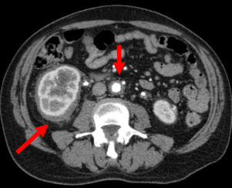

54 yrs male with back pain
Case Credit: Dr. S.harikaran, Dr. C. Amarnath, Stanley medical college, chennai

Slide 3
Coated Aorta Sign - ERDHEIM CHESTER DX
The coated aorta sign is a radiological sign in Erdheim–Chester disease for circumferential infiltration of the aorta Preferentially involv8ng infrarenal portion , which is the most characteristic cardiovascular finding of Erdheim-Chester disease and can be detectable in a CT scan
In this image Hair kidney sign is also seen.
D/D - Lymphoma
Case Credit: Dr. S.Hariharan, Dr. C. Amarnath, Stanley medical college, chennai

Slide 4
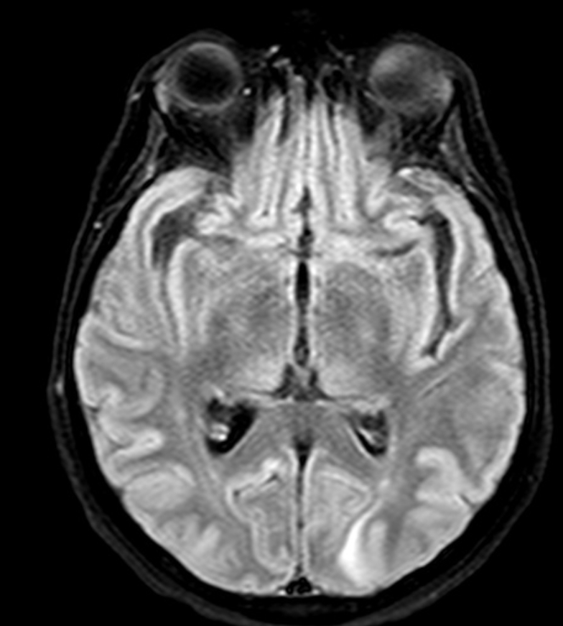
54 yrs male with detoriation of sensorium
Case Credit: Dr. S.Hariharan, Dr. C. Amarnath, Stanley medical college, chennai

Slide 5
Pulvinar Sign - CRUTZFELD JACOB DX
The pulvinar sign refers to bilateral FLAIR hyperintensities involving the pulvinar thalamic nuclei. It is classically described in variant Creutzfeldt-Jakob disease
This sign is also described in
1.Fabry's Disease
2..Bilateral thalamic infarct
3.ADEM
4.Status epilepticus
Case Credit: Dr. S.Hariharan, Dr. C. Amarnath, Stanley medical college, chennai

Slide 6
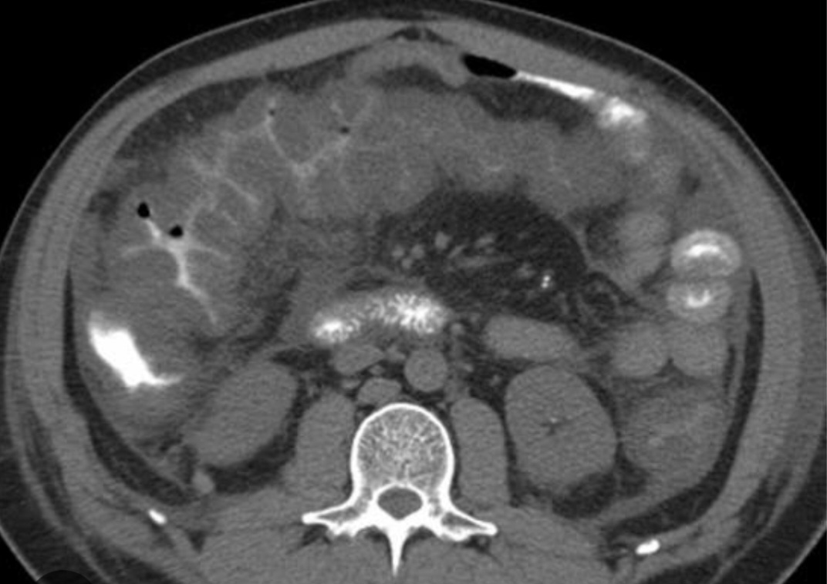
35yr old female with h/o chronic hospitalisation
Case Credit: Dr. S.Hariharan, Dr. C. Amarnath, Stanley medical college, chennai

Slide 7
ACCORDION SIGN - PSEUDOMEMBRANOUS COLITIS
The accordion sign (also known as concertina sign) seen in Pseudomembranous colitis .
This appearance is the result of hyperemic enhancing mucosa stretched over markedly thickened submucosal folds and is also seen when contrast is trapped between edematous haustral folds and pseudomembranes formed on the luminal surface of the colon
Case Credit: Dr. S.Hariharan, Dr. C. Amarnath, Stanley medical college, chennai

Slide 8
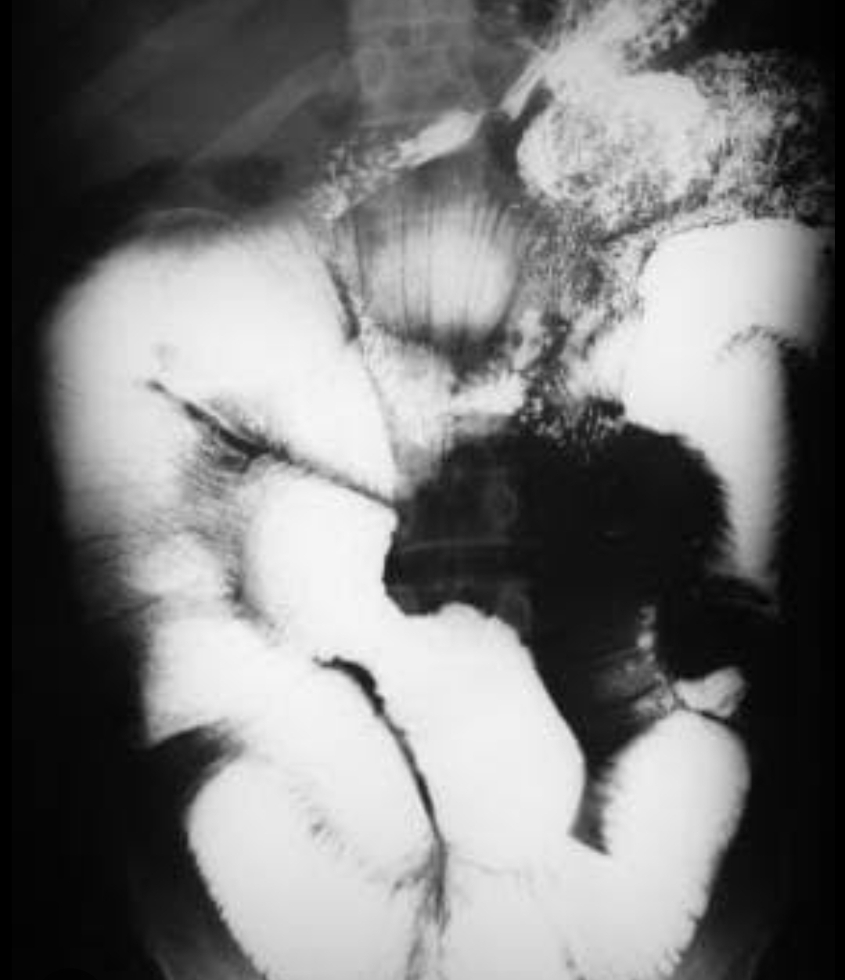
30yr old female with h/o chronic diarrhoea , wt loss .
Case Credit: Dr. S.Hariharan, Dr. C. Amarnath, Stanley medical college, chennai

Slide 9
MOULAGE SIGN - CELIAC DISEASE
The moulage sign is seen Celiac disease.
It occurs where there is a dilated jejunal loop with complete loss of jejunal folds .
It is said to appear like a tube into which wax has been poured.
Case Credit: Dr. S.Hariharan, Dr. C. Amarnath, Stanley medical college, chennai

Slide 10
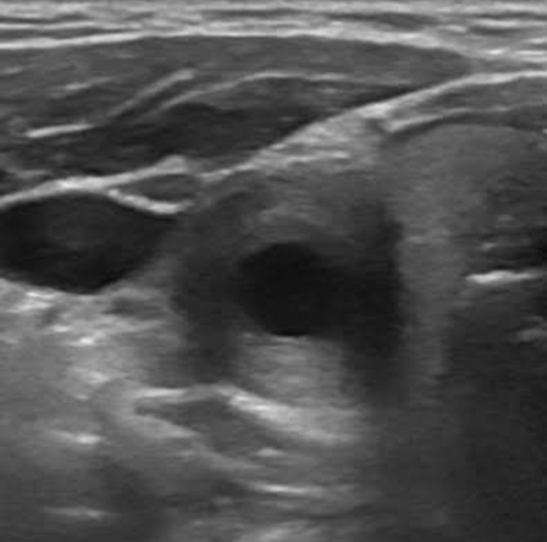
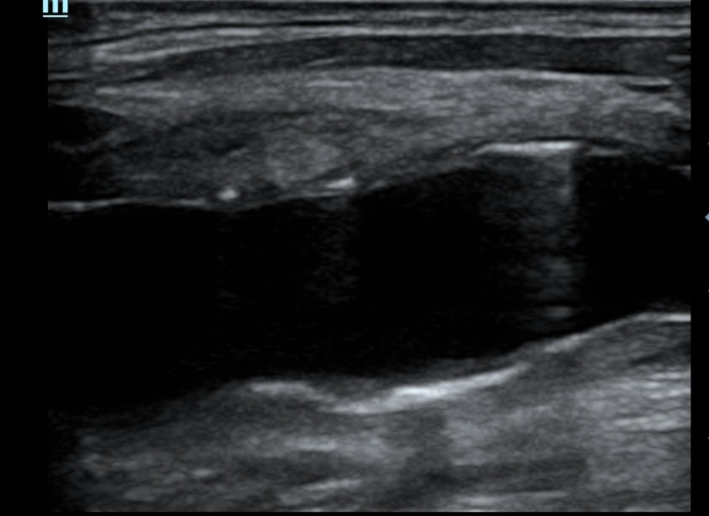
Case Credit: Dr. S.Hariharan, Dr. C. Amarnath, Stanley medical college, chennai

Slide 11
MACRONI SIGN - TAKAYASU ARTERITIS
The macaroni sign is a sign seen in Takayasu arteritis on ultrasound. It represents the smooth, homogeneous and moderately echogenic circumferential thickening of the arterial wall that occurs in Takayasu arteritis.
Case Credit: Dr. S.Hariharan, Dr. C. Amarnath, Stanley medical college, chennai

Slide 12
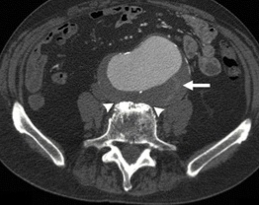
Case Credit: Dr. S.Hariharan, Dr. C. Amarnath, Stanley medical college, chennai

Slide 13
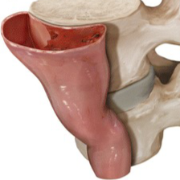
DRAPED AORTA SIGN - CONTAINED RUPTURED ABDOMINAL AORTIC ANEURYSM
The Draped aorta sign is an important imaging feature that can be seen in contained rupture of an abdominal aortic aneurysm. It is highly indicative of aortic wall deficiency.
This sign is considered present when the posterior wall of an aortic aneurysm drapes or molds to the anterior surface of the vertebra
Case Credit: Dr. S.Hariharan, Dr. C. Amarnath, Stanley medical college, chennai

Slide 14
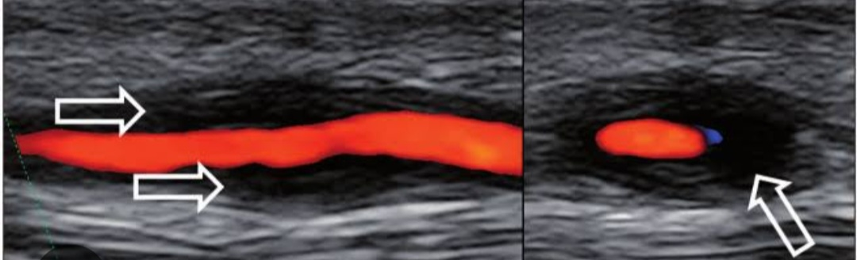
55yr old lady with c/o headache
Case Credit: Dr. S.Hariharan, Dr. C. Amarnath, Stanley medical college, chennai

Slide 15
HALO SIGN - GIANT CELL ARTERITIS
The main finding on US in Giant cell arteritis (GCA) patients is the halo sign: non-compressible hypoechoic wall swelling
The latest meta-analysis suggests sensitivity of 77% and a pooled specificity of 96% for temporal artery
Halo score has been derived based on this finding and implented in the diagnosis and prognostic evaluation of GCA
Case Credit: Dr. S.Hariharan, Dr. C. Amarnath, Stanley medical college, chennai

Slide 16

THANK YOU

